Slide 1
ASIP Synthesis Methodology (ASSIST) Project
Prof. M. Balakrishnan
Department of Computer Science & Engineering
IIT Delhi
29th January 2002

Slide 2
Outline of Presentation
Introduction
Objectives of the project
Work done
Conclusion
Proposed Future Work
Publications

Slide 3
Project Details
ASSIST : ASIP Synthesis Methodology
Start Date : 12th May, 2000
Outline
Introduction
Objectives
Work done
Conclusion
Future work
Publications
Partner institutions
IIT Delhi
University of Dortmund
Faculty
Prof. M. Blalakrishnan
Prof. Anshul Kumar
Students
Manoj Kumar Jain Ph.D.
Rajeshwari M. Banakar Ph.D.
Vishal Bhatt M.Tech.
R. Ram Kumar B.Tech.
Vijay G. Prabakaran B.Tech.
Faculty
Prof. Peter Marwedel
Dr. Rainer Leupers
Students
Lars Wehmeyer Ph.D.
Stefan Steinke Ph.D.

Slide 4
Application Specific Instruction set Processor (ASIP)
Designed for specific application
Exploits special characteristics to meet the desired constraints
Efficient for applications like digital signal processing, automatic control systems, cellular phones

Slide 5
Objectives of the Project
Develop a methodology for exploring the design space in synthesizing an application specific instruction set processor (ASIP).
Outline
Introduction
Objectives
Work done
Conclusion
Future work
Publications
Combine strengths of two institutions
Synthesis and VLSI design strengths of IIT Delhi
Code Generation and architecture strengths of
University of Dortmund

Slide 6
Work done
Survey
Methodology
Register Size Evaluation
Register Windows Evaluation
Cache v/s Scratchpad
Leon Processor Synthesis
Outline
Introduction
Objectives
Work done
Conclusion
Future work
Publications

Slide 7
Survey
Work done
Survey
Methodology
Register Size
Register Windows
Cache/ Scratchpad
Leon Proc. Synth.
Approaches suggested in the last decade studied and classified
Based on this study a survey paper was presented in last year’s VLSI conference
Jain, M.K.; Balakrishnan, M.; Anshul Kumar :
“ASIP Design Methodologies : Survey and Issues”, VLSI 2001

Slide 8
Flow Diagram of ASIP Design Methodology
Application &
Design Constraints
Application Analysis
Architectural Design Space Exploration
Instruction Set
Generation
Code Synthesis
Hardware Synthesis
Object Code
Processor Description

Slide 9
Major Classification
Microarchitecture fixed => Instruction set selected within the flexibility of the fixed microarchitecture
First select a microarchitecture => Instruction set selected based on the selected microarchitecture

Slide 10
Architectural Features Explored
storage units & interconnect resources [Gong 95]
pipelined vs. non-pipelined Fus [Binh 96]
issue width, cache size, branch units [Kin 99]
operation slots, latency of FUs [Gupta 2000]
addressing support [Ghazal 2000]
instruction packing [Ghazal 2000]
dual multiply-accumulate [Ghazal 2000]
complex multiplication [Ghazal 2000]

Slide 11
Architecture Design Space: Issues to be addressed
Most approaches consider only flat memory
Kin [1999] consider I/D cache sizes but limited architectures explored
Flexibility in number of pipeline stages not explored

Slide 12
Methodology : ASSIST Flow Diagram
Application
Constraints
Profiler
Parameter
Extractor
Application Parameters
Basic
Processor
Config.
Component
Power
models
Configuration
Selector
Processor
Pipeline +
models
# of clocks
Estimator
Power
Estimator
Area and
Clock Period
Estimator
Area and
Clock period
data
Processor
Configurations
Work done
Survey
Methodology
Register Size
Register Windows
Cache/ Scratchpad
Leon Proc. Synth.
Design Space Explorer
Retargetable
Compiler Generator
Synthesizable
VHDL Generator
ASIP Compiler
Synthesizable
VHDL

Slide 13
Methodology : ASSIST Flow Diagram
Register size evaluation
Register windows exploration
Cache-Scratchpad
Application
Constraints
Profiler
Parameter
Extractor
Application Parameters
Basic
Processor
Config.
Component
Power
models
Configuration
Selector
Processor
Pipeline +
models
# of clocks
Estimator
Power
Estimator
Area and
Clock Period
Estimator
Area and
Clock period
data
Processor
Configurations
Design Space Explorer
Retargetable
Compiler Generator
Synthesizable
VHDL Generator
ASIP Compiler
Synthesizable
VHDL

Slide 14
Methodology : ASSIST Flow Diagram
Application
Constraints
Profiler
Parameter
Extractor
Application Parameters
Basic
Processor
Config.
Component
Power
models
Configuration
Selector
Processor
Pipeline +
models
# of clocks
Estimator
Power
Estimator
Area and
Clock Period
Estimator
Area and
Clock period
data
Processor
Configurations
Design Space Explorer
Leon Processor Syn.
Retargetable
Compiler Generator
Synthesizable
VHDL Generator
ASIP Compiler
Synthesizable
VHDL

Slide 15
Register Size Evaluation: Problem Definition
Work done
Survey
Methodology
Register Size
Register Windows
Cache/ Scratchpad
Leon Proc. Synth.
Study the impact of changing the number of
registers on
Performance (# cycles)
Power
Energy
Code size

Slide 16
Register Size Evaluation: Methodology
Parameterized compiler for ARM
Execution
Code-size, cycle, power and energy analysis
Parameter values
Decision for next parameter value

Slide 17
Experimental Setup
Benchmark
Suite
encc
Compiler
Instruction Set
Simulator
Register File
Size
Trace Data

Slide 18
encc Compiler Environment
C Code
encc
assembly
Assembler &
Linker
executable
energy
database
profiling
information
trace
analyzer
trace file
ISS

Slide 19
Results
Range Number of registers 3 to 8
Memory configurations
- only off chip
- on-chip instruction off-chip data
Results collected
- number of instructions executed
- number of cycles
- ratio of spilling instructions (static)
- power consumption
- energy consumption

Slide 20
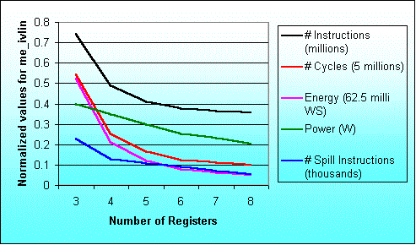
Result for the program me_ivlin
knee due to exec. time reduction
knee due to power saving

Slide 21
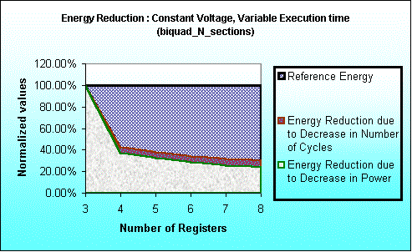
Time saving and Power saving contributions in Energy Saving

Slide 22
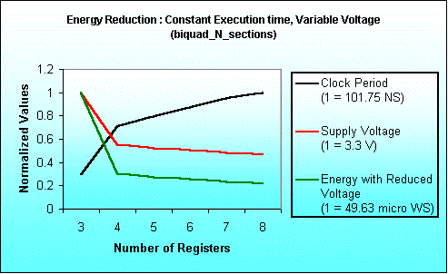
Energy Saving due to
Voltage Scaling
Notes:
Here we have assumed total execution time as constant.
To keep execution time as constant when execution requires lesser number
of cycles we have increased the clock period.
With the increased clock period we can reduce supply voltage.
For estimating supply voltage with varying clock period we had referred
The paper titled “Low Power CMOS Digital Design” – A.P Chandrakasan et al
IEEE J. Solid-State Circuits, Vol. 27, No. 4, pp. 473-484, April 1992.
With this estimated voltage we have calculated Energy.
Since Energy is product of Average Power Consumption and Execution time,
here Execution time is constant and
Power depends quadratically on Voltage.
Keeping these facts into consideration we have computed
Energy Consumption.

Slide 23
Maximum variation in results
Benchmark Program | Performance |  | Power |  | Energy
 | Reg. size | % inc. | Reg. size | % red. | Reg. size | % red.
biquad_N_sections | 3 → 4 | 57.5 | 3 → 4 | 12.6 | 3 → 4 | 62.9
lattice_init | 4 → 5 | 20.5 | 6 → 7 | 1.0 | 4 → 5 | 21.0
matrix-mult | 3 → 4 | 29.7 | 7 → 8 | 7.4 | 3 → 4 | 33.4
me_ivlin | 3 → 4 | 53.4 | 5 → 6 | 15.3 | 3 → 4 | 59.3
bubble_sort | 4 → 5 | 46.3 | 4 → 5 | 17.3 | 4 → 5 | 55.6
heap_sort | 6 → 7 | 25.6 | 6 → 7 | 10.3 | 6 → 7 | 33.2
insertion_sort | 4 → 5 | 44.8 | 4 → 5 | 22.3 | 4 → 5 | 57.1
election_sort | 3 → 4 | 22.2 | 5 → 6 | 14.0 | 5 → 6 | 30.1
Average |  | 37.5 |  | 12.5 |  | 44.1

Slide 24
Conclusion
Studied results for number of inst. executed cycles, spilling, power and energy consumption for ARM7TDMI processor. Similar results for LEON processor.
Range of number of registers 3 to 8.
Single increase in number of registers results in up to 57.5% performance improvement and 62.9% reduction in energy consumption.

Slide 25
References
Jain, M.K.; Balakrishnan, M.; Anshul Kumar : “ASIP Design Methodologies : Survey and Issues”, VLSI design 2001.
Jain, M.K.; Wehmeyer, L.; Steinke, S.; Marwedel, P.; Balakrishnan, M. : “Evaluating Register File Size in ASIP Synthesis”, COSES 2001.
Wehmeyer, L.; Jain, M.K.; Steinke, S.; Marwedel, P.; Balakrishnan, M. : “Analysis of the Influence of the Register File Size on Energy Consumption, Code Size and Execution Time”, IEEE TCAD, vol. 20, no. 11, Nov. 2001.

Slide 26
Register Windows Evaluation: Problem Definition
Work done
Survey
Methodology
Register Size
Register Windows
Cache/ Scratchpad
Leon Proc. Synth.
Performance analysis for the
ASIP parameter,
number of register windows

Slide 27
Register Windows
A set of registers
Typically the set is divided into three subsets: the out, in and the local registers
Overlapping registers : Sparc V8 type architecture

Slide 28
Overlapping Register
Overlapping Registers
W3 outs
W0 ins
W3 locals
W2 outs
W3 ins
W0 locals
W2 locals
W0 outs
W1 ins
W1 outs
W2 ins
W1 locals

Slide 29
Effects of Number of Windows
Program
Memory
f1
f4
f1
f2
f3
f3
f2
f4
f5

Slide 30
Effects of Number of Windows
Program
Memory
f1
f4
f1
f2
f3
f1
f3
f2
f4
SPILL
f5

Slide 31
Effects of Number of Windows
Program
Memory
f1
f4
f5
f2
f3
f1
f3
f2
f4
SPILL
f5

Slide 32
Register Windows Evaluation: Methodology
Application
..……..
…..…..
………
………
………
Step 1
Memory
Access Time
Models
Identify function calls
Insert Statements
..……..
…..…..
F();
………
………
Modified Application
Compile & Execute
Step 2
Compute
T _{avg_access}
Spill Count
..……..
DS();
F();
DS();
………
T _{avg_access}
Compute Time Penalty
Step 3
Time Penalty

Slide 33
Spill Count Computation
Problem can be modeled by regular language recognition problem
The Problem :
  Represent the application as a sequence of c’s and r’s
  For every NRWs, we have a predefined r.e. (regular expression)
  Find the number of matches of each r.e. in the application string

Slide 34
Memory Access Time Models
Processor design goes hand-in-hand with memory design
Decision diagram for memory configuration has been developed

Slide 35
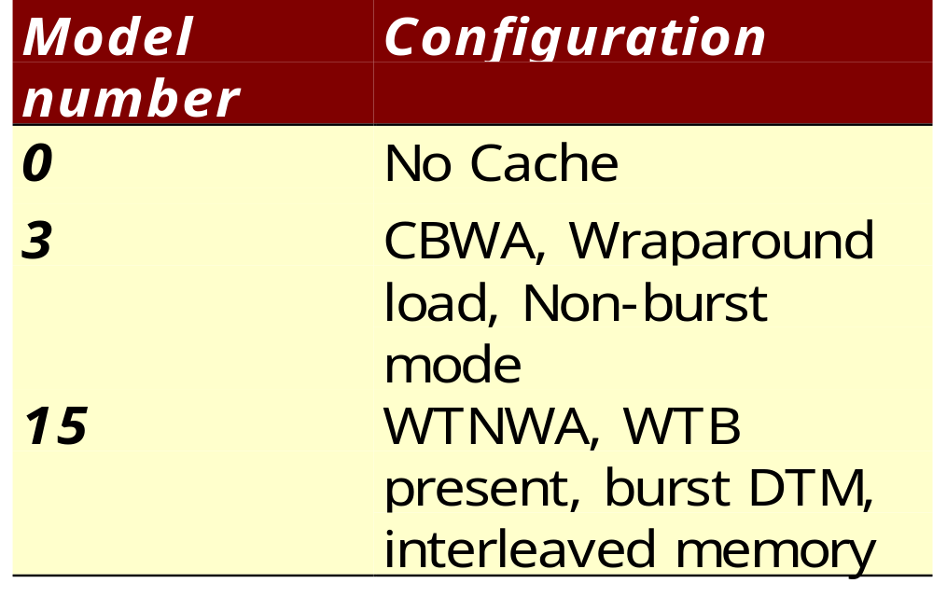
Memory Models considered
Three
of the
sixteen
models
considered

Slide 36
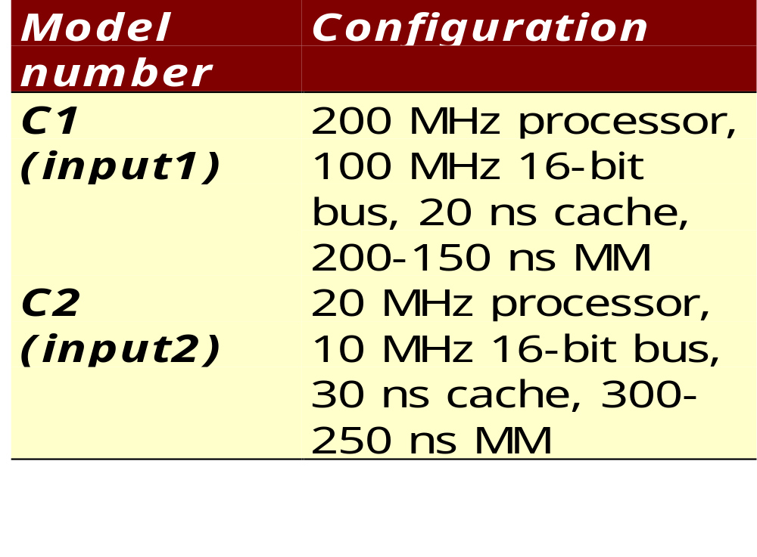
System Configurations

Slide 37
Total Execution Time
Penalty time = [ No of penalty words for given NRWs ]*
[ Average memory access time for
corresponding system configuration ]
Total Execution time = [ {4*(Branch count) +
2*(Ld_Str count) +
1*(Others)} * {Cycle time for
corresponding system
configuration}] +
[ Penalty time for corresponding
NRWs ]

Slide 38
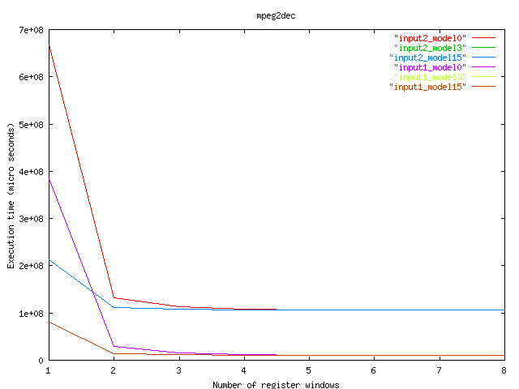
Execution time for MPEG Decoder

Slide 39
References
Bhatt, V.; Balakrishnan, M.; Anshul Kumar : “Register Windows Analysis in ASIPs”, VLSI 2002.

Slide 40
Cache v/s Scratchpad : Objectives
Develop a systematic framework to evaluate area, performance and energy of cache/scratch pad based systems.
Develop the area model for varying sizes of cache/scratchpad memory.
Performance model
Energy model
Work done
Survey
Methodology
Register Size
Register Windows
Cache/ Scratchpad
Leon Proc. Synth.

Slide 41
Target Architecture
AT91M40400 - a member of ATMEL AT91 16/32 bit microcontroller family based on ARM7TDMI processor.
ARM7TDMI has 4k on chip scratchpad.
DSPStone benchmark suite.
Compiler support - Packing algorithm
Maps the frequently accessed blocks of the application to the scratchpad.
Main
Memory
Cache
Scratch
pad
Cache

Slide 42
Methodology: Flow Diagram
application
ARMulator
Cache Performance
encc
Energy
Cache/Scratchpad
size
CACTI
Packing Algorithm
Area Model
Area
Trace analysis
Scratchpad Performance

Slide 43
Cache and Scratch pad Memory
Input
TAG
array
DATA
array
Decoder
Wordlines
Scratch pad memory
Decoder
Data array
Bitlines
Column
Mux
Column
mux
Column
Mux
Peripheral
Circuitry
Sense
amplifiers
Sense
amplifier
Comparators
Output
driver
Mux drivers
Output
driver

Slide 44
Energy models
Cache Energy Model
E_ca_total = (N_read + N_write) * E_cache
where N_read = Number of read accesses,
N_write = Number of write accesses obtained from the
memory interaction model.
E_cache = Energy per access of cache obtained from CACTI .
E_ca_total = Total energy spent in cache.
Scratch pad Energy Model
E_sptotal = SP_access * E_scratchpad
where SP_access = number of scratchpad accesses
obtained from the trace analysis.
E_scratchpad = the energy per access.
E_sptotal = the total energy in the scratch pad

Slide 45
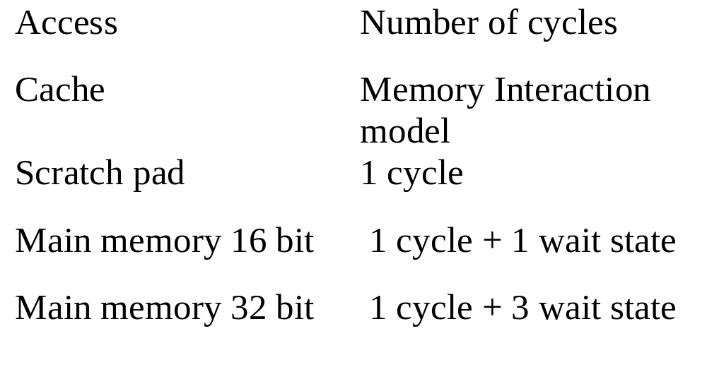
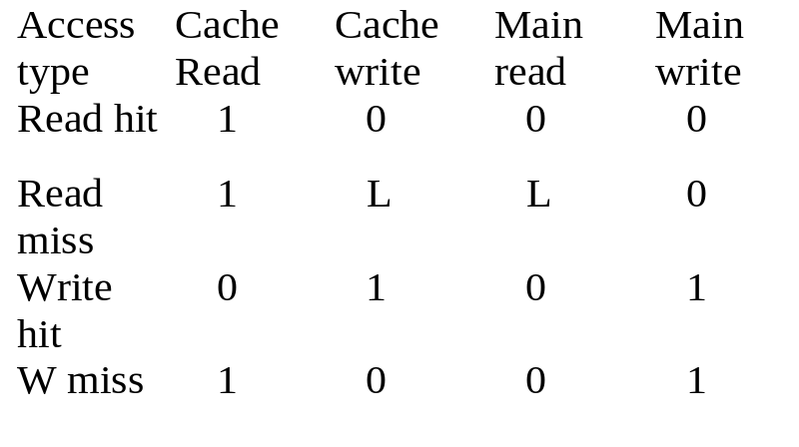
Memory Access Model
Memory Interaction Model

Slide 46
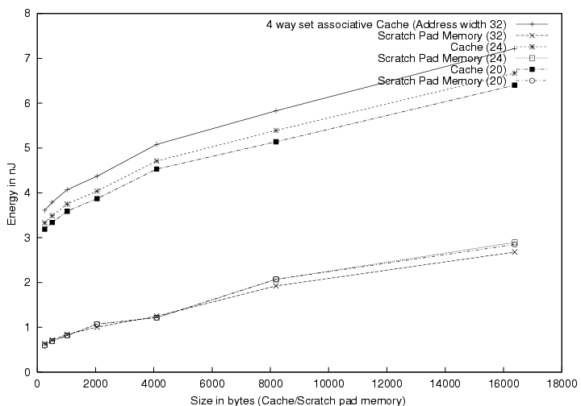
Energy per access
Cache
Scratch pad

Slide 47
Results for bubble_sort
Area reduction : 34%
Energy reduction : 40%
Time reduction : 18%
Area Time reduction : 46%

Slide 48
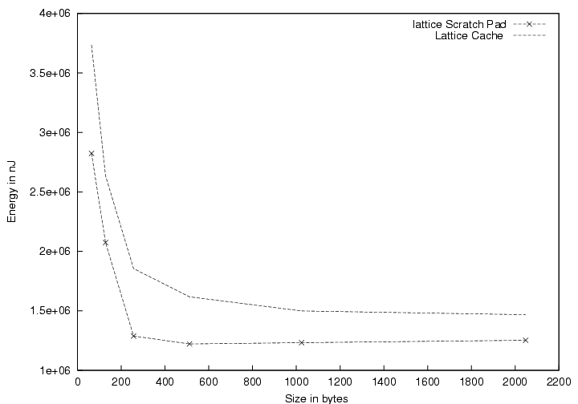
Energy Consumption for lattice
Cache
Scratch pad

Slide 49
Leon Synthesis Objectives
Synthesize Leon processor for different configuraions
Generate a database of area and clock period for different configurations to assist in ASIP design space exploration
Identify and incorporate more architectural features
Work done
Survey
Methodology
Register Size
Register Windows
Cache/ Scratchpad
Leon Proc. Synth.

Slide 50
Salient features of Leon Processor
Simple VHDL code
VHDL code freely available at http://www.gnu.org
Synthesizable on variety of targets (ASIC and FPGA)
Good documentation
Active online help
SPARC V8 architecture
Many on-chip features considered
Separate instruction and data caches
On-chip AMBA AHB/APB buses
8/16/32-bit memory bus with PROM and SRAM support
Interrupt controller, two UARTs
Flexible Memory Controller

Slide 51
Architectural features varied
Number of register windows
Register Window Size ^{(new)}
Instruction cache size
Presence/ absence of multiplier

Slide 52
Leon Synthesis: Achievements
LEON processor synthesized and mapped to XILINX FPGAs
New features like changing the number of registers in a window incorporated
A database of area and clock period for different configuration created to help design space exploration in ASIP synthesis

Slide 53
Leon Synthesis: Achievements contd.
Estimator using the data base generated produced good results
Procedure for synthesis to FPGA and ASIC targets developed with writing necessary scripts
Modifications were done to LEON processor ports for its interface with ADM-XRC board resources

Slide 54
Conclusion
Impact of register file size variation in ARM and LEON processor on performance, code size, power and energy
Impact of number of register windows on performance
Trade off between scratch-pad and cache memories for ARM and LEON processor
Area and clock period results by various LEON configurations
Outline
Introduction
Objectives
Work done
Conclusion
Future work
Publications

Slide 55
Proposed Future Work
An extensive case study to illustrate the methodology
Design space exploration with ASSET (framework at IIT Delhi) and validation using the compile-simulation technique currently being used
FPGA implementation of LEON processor to validate the methodology
Outline
Introduction
Objectives
Work done
Conclusion
Future work
Publications

Slide 56
Publications (Journal and Reviewed Conferences Papers
Jain, M.K.; Balakrishnan, M.; Anshul Kumar : “ASIP Design Methodologies : Survey and Issues”, VLSI 2001.
Jain, M.K.; Wehmeyer, L.; Steinke, S.; Marwedel, P.; Balakrishnan, M. : “Evaluating Register File Size in ASIP Synthesis”, COSES 2001.
Wehmeyer, L.; Jain, M.K.; Steinke, S.; Marwedel, P.; Balakrishnan, M. : “Analysis of the Influence of the Register File Size on Energy Consumption, Code Size and Execution Time”, IEEE TCAD, vol. 20, no. 11, Nov. 2001.
Bhatt, V.; Balakrishnan, M.; Anshul Kumar : “Register Windows Analysis in ASIPs”, VLSI 2002.
Outline
Introduction
Objectives
Work done
Conclusion
Future work
Publications

Slide 57
Publications
(Conferences Papers)
Wehmeyer, L.; Jain, M.K.; Steinke, S.; Marwedel, P.; Balakrishnan, M. : “Using a retargetable, Energy aware Compiler Framework for Deciding Number of Registers in ASIP Design”, Fifth International Workshop on Software and Compilers for Embedded Systems, SCOPES 2001, 20-22 March, 2001, St. Goar, Germany.
Banakar, R.; Bose, R.; Balakrishnan, M. : “Low Power Design: Abstraction levels and RT level design techniques”, VLSI Design and Test Workshop, VDAT 2001, Aug. 2001, Banglore, India.

Slide 58
Publications (Technical Reports)
Jain, M. K. : “ASIP Design Methodologies : Survey and Issues”, TR #2000/24, Embedded Systems Project, Department of Computer Science and Engineering, IIT Delhi.
Jain M. K., Wehmeyer, L.; Marwedel, P.; Balakrishnan, M. : “Register File Synthesis in ASIP Design”, TR #2000/746, Department of CS XII, University of Dortmund, Germany.
Kumar, R. R.; Prabakaran, V. G. : “Application Specific Instruction Set Processor Synthesis and Estimation”, TR # 2000/29 (B.Tech. Project report), Embedded Systems Project, Department of Computer Science and Engineering, IIT Delhi.
Bhatt, V. V. : “Register Window Analysis in ASIPs”, TR #2000/36 (M.Tech. Project Report), Embedded Systems Project, Department of Computer Science and Engineering, IIT Delhi.
Banakar, B.; Steinke, S.; Lee, B. S.; Balakrishnan, M.; Marwedel, P. : “Comparison of Cache and Scratch-Pad based memory Systems with respect to Performance, Area and Energy Consumption”, TR #2001/762, Department of CS XII, University of Dortmund, Germany.

Slide 59
ASIP Synthesis and Retargetable Code Generation Workshop
Jan. 2, 2002 to Jan. 4, 2002
IIT Delhi
The topics covered :
Memory Optimizations
Architectural Exploration for
Programmable Embedded
Systems
VLIW Synthesis
Retargetable Compiler
Technology
Code Generation Techniques
The Speakers :
Prof. M. Balakrishnan, IIT Delhi
Prof. Anshul Kumar, IIT Delhi
Prof. Paolo Ienne, EPFL
Dr. Preeti Ranjan Panda, Synopsis Inc.
Prof. Nikil Dutt, UC Irvine
Prof. Peter Marwedel, Univ. of Dortmund
Dr. Uday Khedker, IIT Bombay
Dr. Rainer Leupers, Univ. of Dortmund

Slide 60
Thanks

